Slide 1



BUSINESS DEVELOPMENT
Strategic business planning
Funded by the European Union. The views and statements expressed herein reflect the views of the author(s) and do not necessarily reflect the official position of the European Union or the Education, Audiovisual and Culture Executive Agency (EACEA). Neither the European Union nor the EACEA can be held responsible for them. Project number: 2024-1-RO01-KA210-ADU-000254716

Slide 2





LEAP partnership:
Presented by:
ZSUZSANNA SÁNDOR-MAJOROS

Slide 3
Contents
Why?
03.
01.
How?
Customer relationships, channels, resources and activities
Business model, business plan
What?
For whom?
02.
04.
How sustainable is it?
Value proposition, customer segments and target market
Partner relationships
Cost plan and revenue structure

Slide 4
Entrepreneurial facts and myths: which is which?
If your product is good, you'll be successful—all you need is a good idea!
People prefer sustainable products—they are willing to pay more for them.
As an entrepreneur, you have to take big risks and work hard on both fronts.
At first, you have to do everything on your own.
Our revenue is also our profit.
Entrepreneurship thrives solely on ingenuity and skill.
You have to succeed right from the start.
Never give up.
X
X
X
X
X
X
X
X

Slide 5
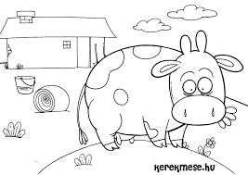

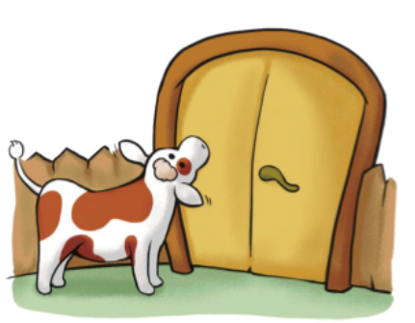
The silly (?) cow
Developing an innovative idea
We are familiar with some of the cows’ characteristics… but others have remained hidden from us until now ☺
        Let’s see what innovative business opportunities these animals might hold!

Slide 6

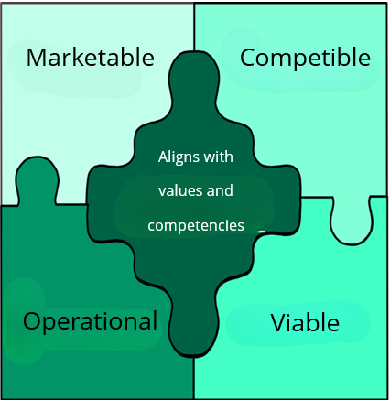
Business idea
Does it align with your values and skills?
Idea generation: the origins of the model
Family ‘legacy’, generational change;
Thinking through current consumer trends;
Identifying unmet market needs;
Consulting a wider circle of acquaintances;
Adapting ideas from other geographical areas (Hawaiian chimney cake, Pest-style kebab);
Adopting successful models from other organisations (e.g. franchises or licences)
Consciously applying creative techniques (e.g. brainstorming, mind mapping, design thinking, etc.);
Reflecting on your own skills: what do I really know how to do, what am I good at?
What is your story?
How do you rate your own business idea?

Slide 7
Why do we need a business model and a business plan?
  Every business has a business model (even if only in a latent, unconscious way)
  We have an idea of who buys or will buy our products or services, and why our product or service is good
  If we do not test these ideas or reflect on them, we can easily become their prisoners!
BANKRUPTCY, FAILURE

Slide 8
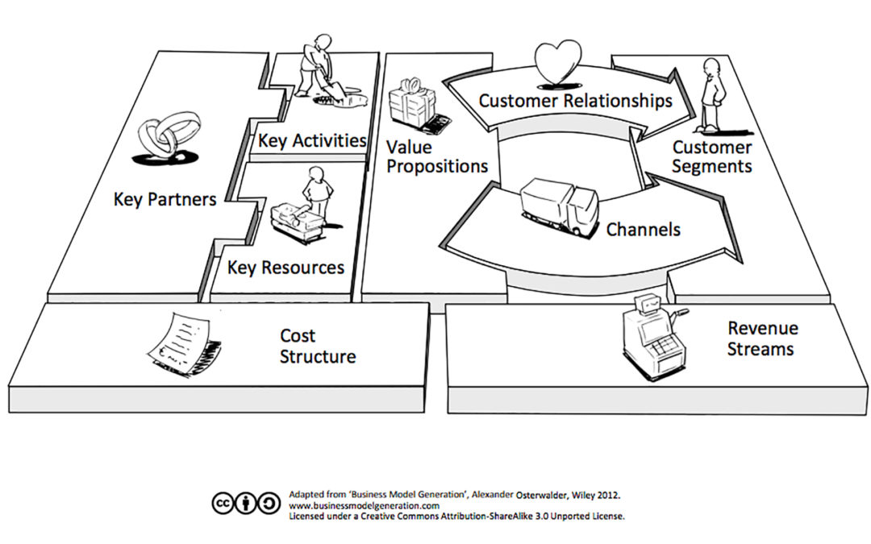
Business Model Canvas (BMC): a model to help you make the right decisions

Slide 9
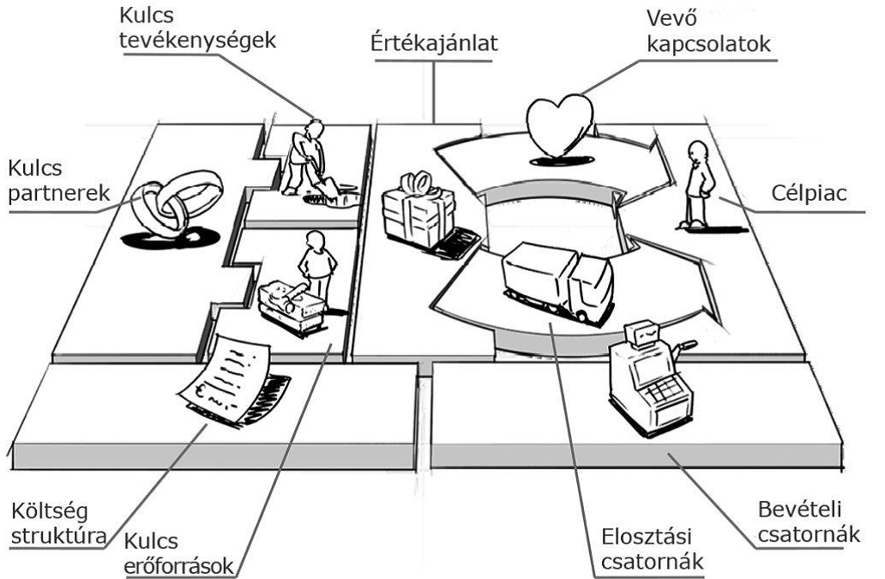
1 – 2. Customer groups (target market) + Value proposition
What actually characterises the customers I’m targeting?
What groups could they be categorised into?
What are their needs and problems?
How does my product or service address these?
Who would be willing to pay for this? Are there enough of them?
Should I narrow down or change the target group? Should I modify the product or service?
1.
2.

Slide 10
3-4. Customer relations – (distribution) channels
What is the best way to make them aware that we exist?
How can we encourage them to choose us?
How can the purchase be made?
Is there anything else we need to do after the purchase?
How do I retain the customer?
How can we do all this cost-effectively?
3.
4.

Slide 11
5–6. Key (priority) activities + Key (priority) resources
What are the critical aspects that require particular attention during implementation?
What do I need to be able to actually produce and create value?
...to operate the channels and manage customer relationships effectively?
...generate revenue?
5.
6.

Slide 12
7. Key (priority) partners
What are we – or should we be – really good at? What are others better at?
What can we achieve with others by working together with less risk / at a lower cost / to a higher standard / more quickly?
What do we do ourselves, and what do we leave to others?
Are we sure we need our own...?
7.

Slide 13
8. Cost structure
How much will all this cost?
Have I thought of all the costs? (Taxes, contributions, duties, wastage, sick leave, etc.)
When will these costs arise?
How can I reduce costs?
What happens if I can sell less?
8.

Slide 14
9. Revenue
What kind of revenue are we targeting?
What is the value to my customer, and what price can I set? What pricing strategy should I use?
How much can I expect to sell?
What will my total revenue be? Over what time period?
9.

Slide 15
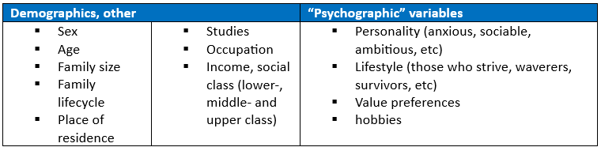
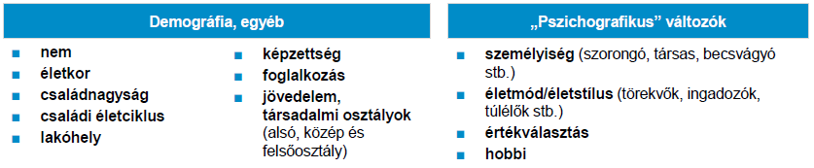
1. Customer group: characteristics

Slide 16
1. Customer group: segmentation
Brand loyalty: strong, moderate, weak, variable, fickle
Personality traits: assuming that consumers with different personalities exhibit differences in product usage
Product usage: users (low, high, medium) / non-users (winnable, unwinnable).
Product benefits: which product attribute do consumers prefer
Compromise choice: when product benefits are equally important, consumers tend to choose intermediate solutions
By stages of the purchasing process (relating to the specific product/service): not aware / aware / well-informed / interested / desiring it / wanting to buy it

Slide 17
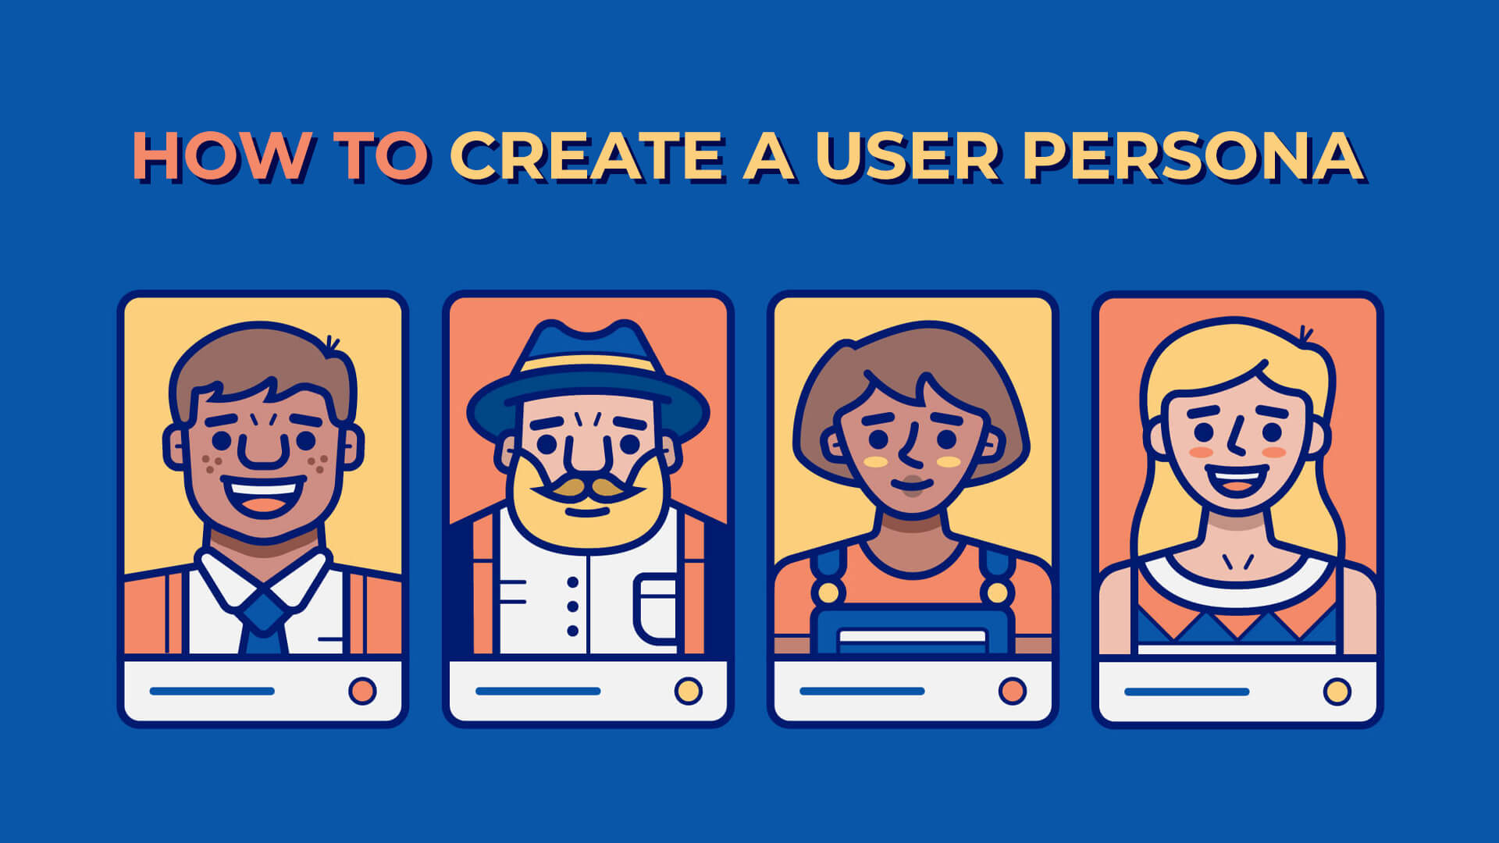
Customer base
(customer groups)
Target market
(demand)
1. Customer group: understanding
To gain a deeper understanding of our customers and estimate their numbers, we often need to conduct research!
Online research
Analysis of statistical data
Questionnaires (online)
Joining online groups
Participant observation
Interviews
Focus group interviews
Source: https://www.sitecentre.com.au/blog/how-to-create-a-user-persona

Slide 18
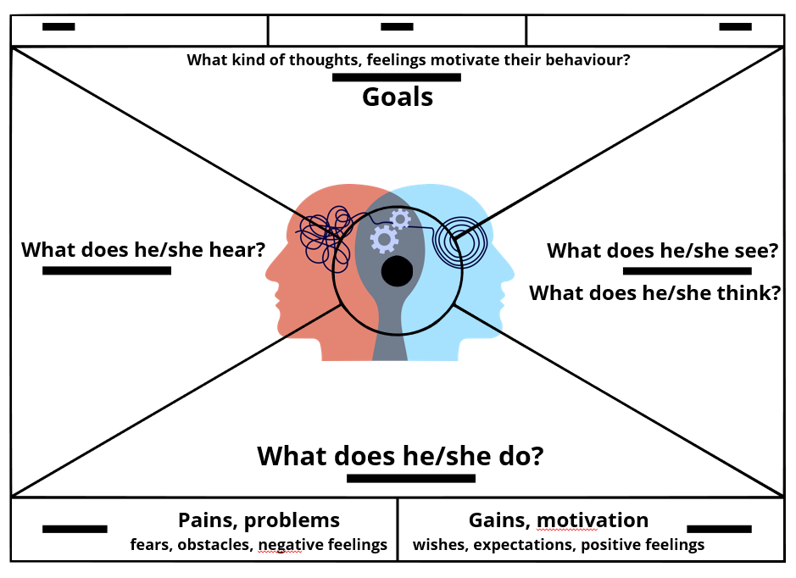
1. Customer group: understanding, profiling – EMPATHY MAP

Slide 19
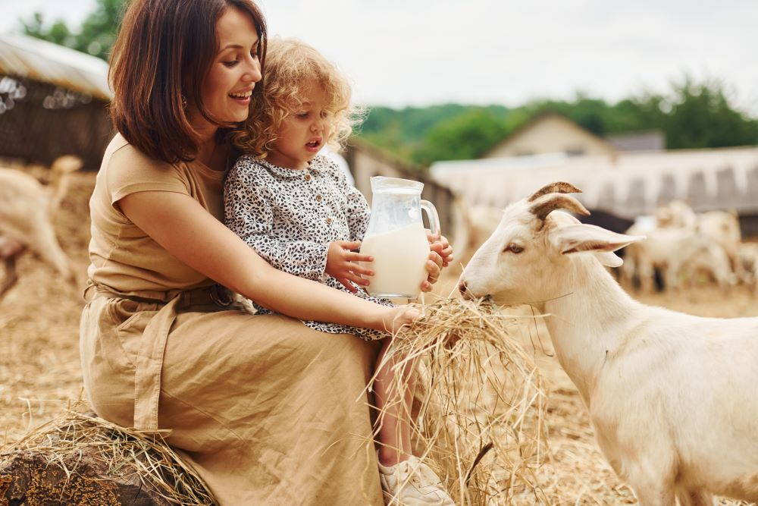
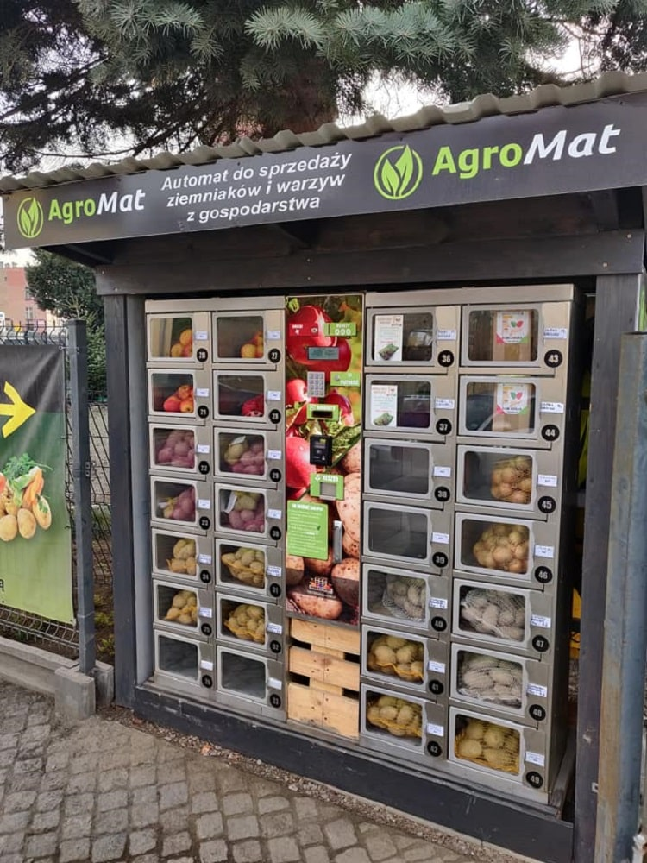
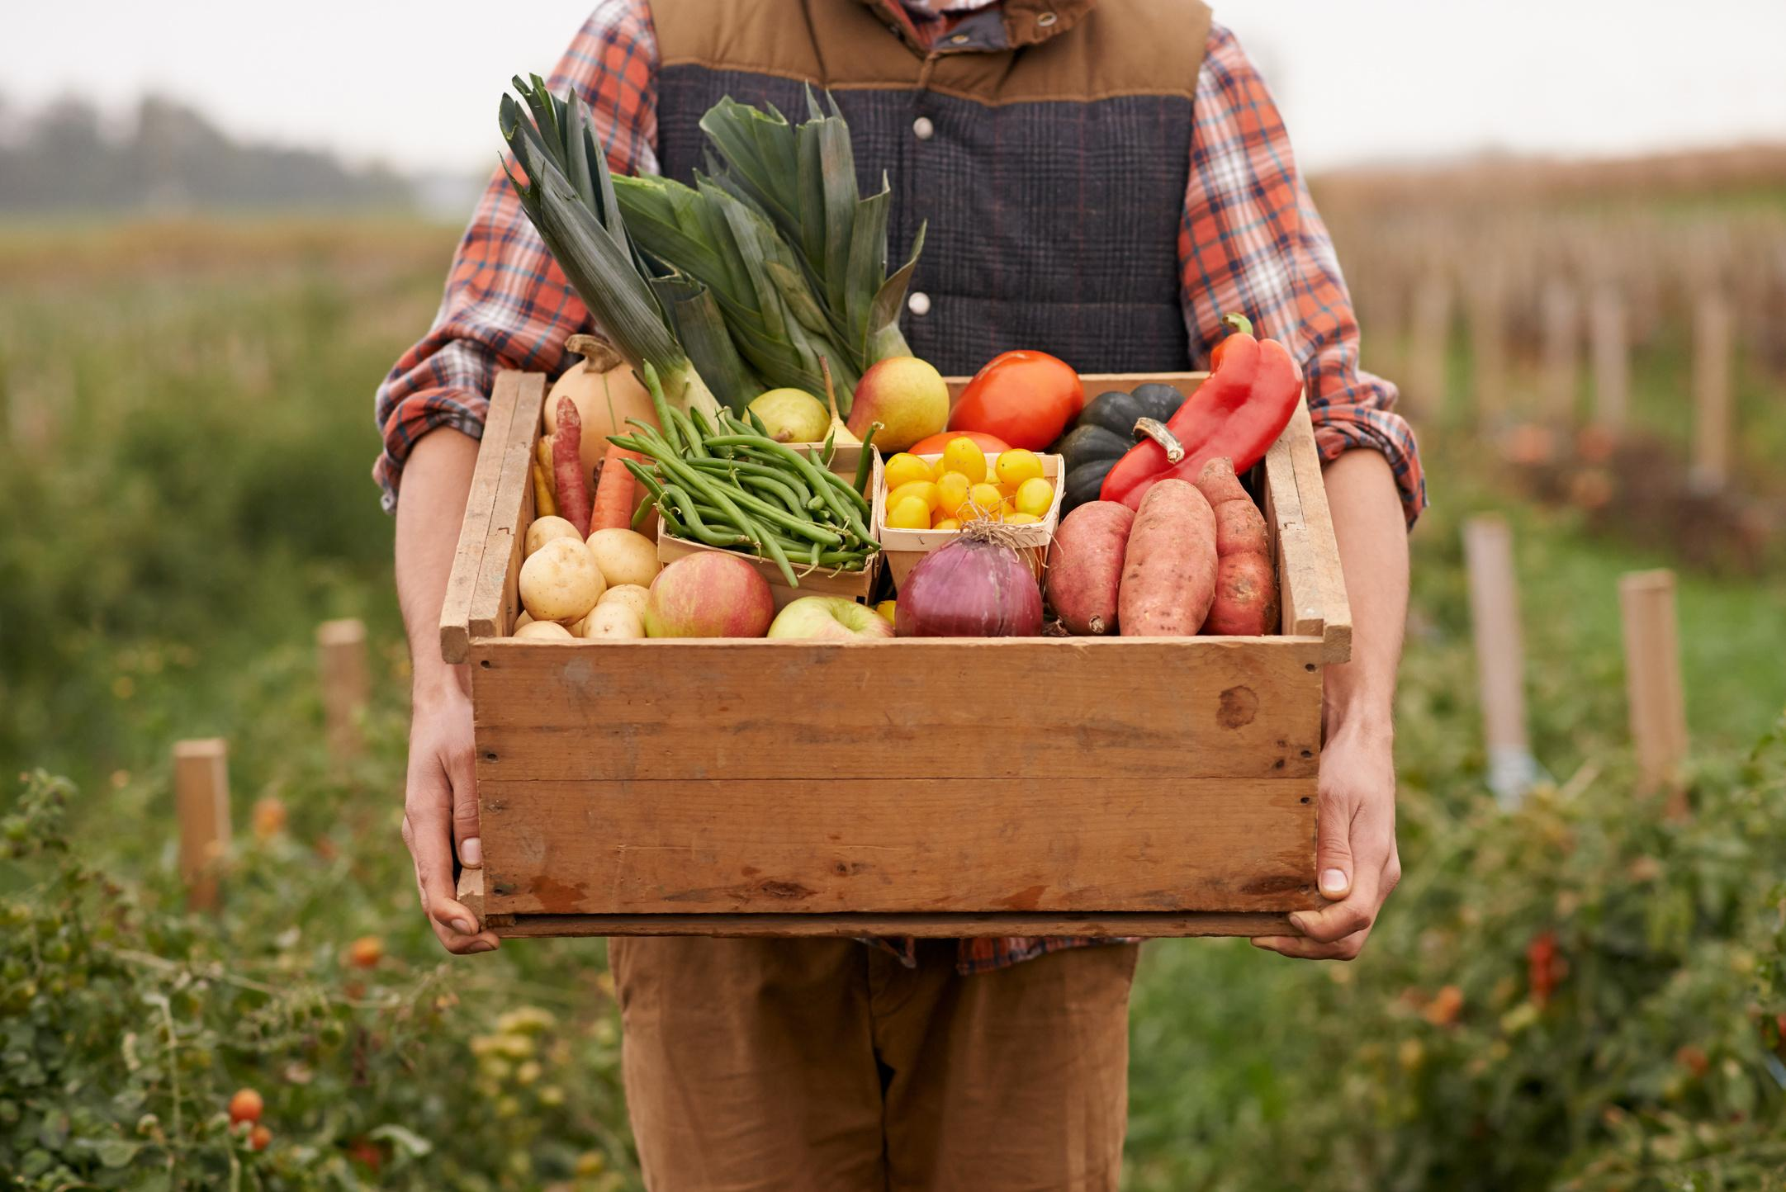
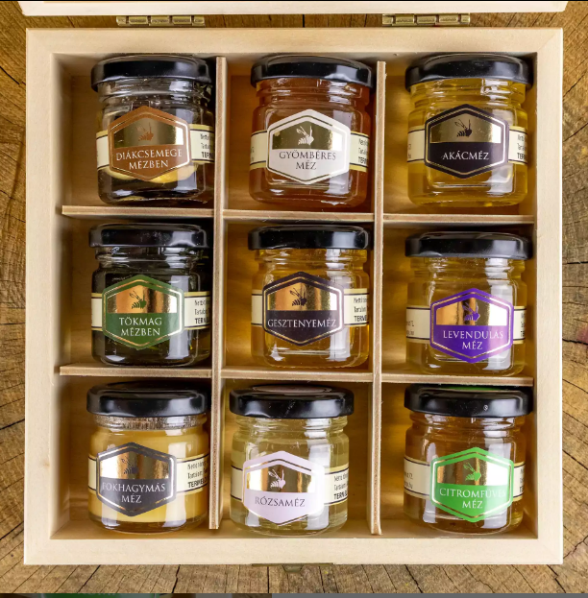
2. Value proposition
What does my product/service mean to the customer?
Value proposition: the set of characteristics why customers
1. will buy
2. will buy our product.
Source: nak.hu, agroinform.hu
mezesgergo.hu

Slide 20
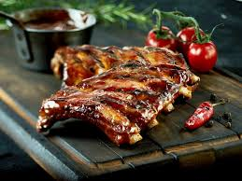

2. Value proposition
What does my product/service mean to the customer?
Value proposition: the set of characteristics why customers
1. will buy
2. will buy our product.
Source: promobil.hu, chilion.hu
mezesgergo.hu

Slide 21
2. Elements of the value proposition
Design
03.
New
Brand, status
Price
01.
Customer relationships, channels, resources and activities
Business model, business plan
Risk mitigation
Performance
Customisability
Reliability
How good is the value proposition?
02.
04.
Value proposition, customer segments and target market
Partner relationships
Cost plan and revenue structure
Availability
Ease of use
Sense of support, principles
.....?
How do these factors manifest themselves in your product or service?

Slide 22
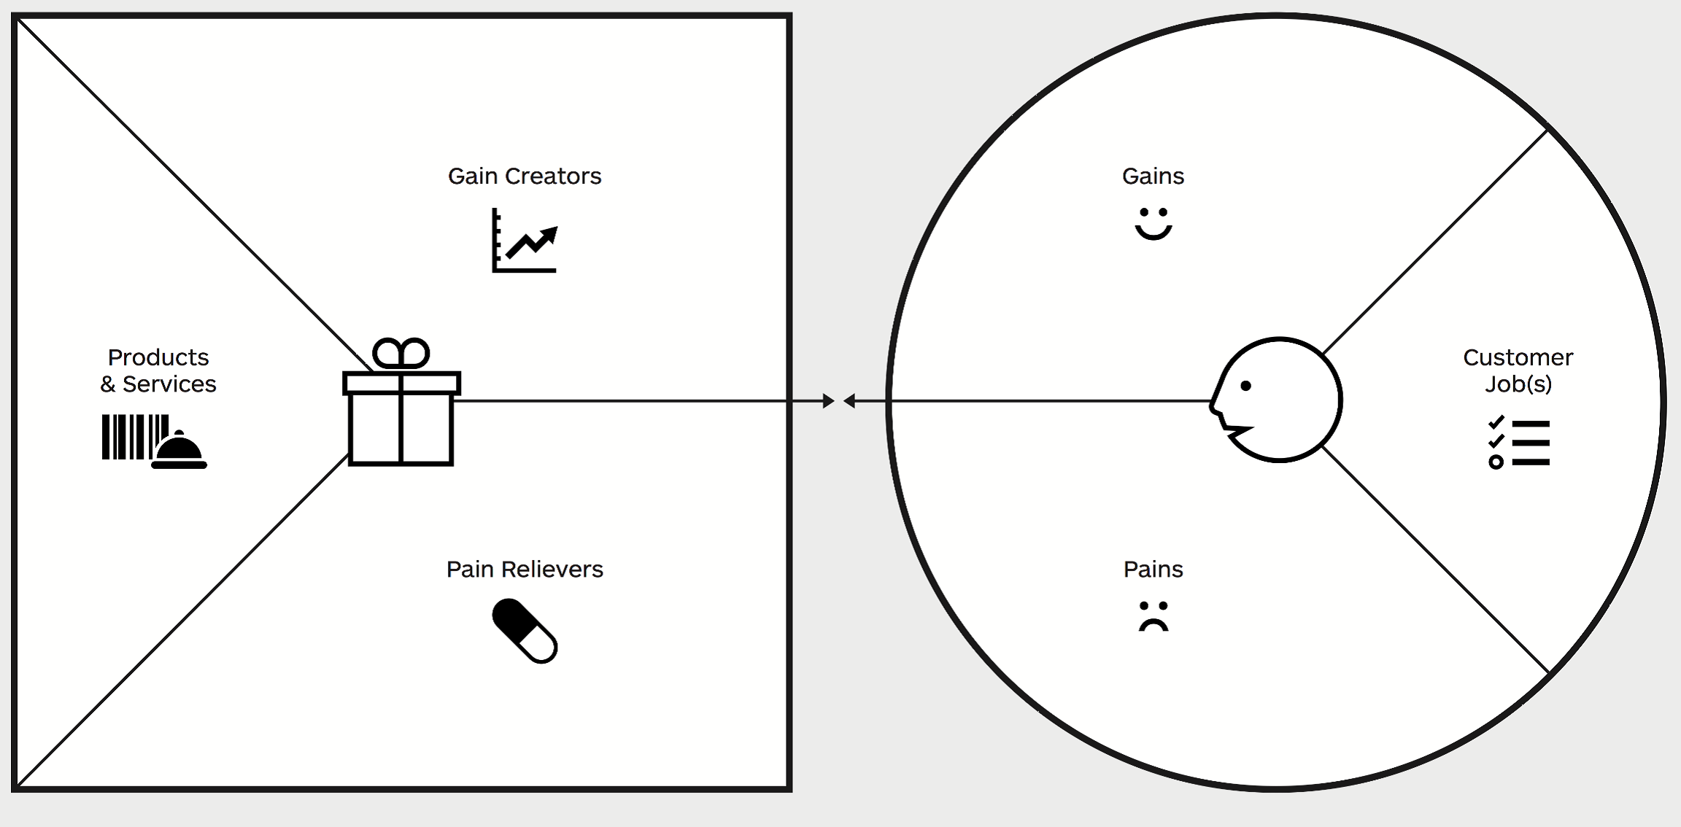
2. Value proposition: the value proposition canvas as a planning tool (based on the empathy map)
Providing profit, benefit or advantage
Desires – gains
Products/services
Tasks
Pain relief
Pains, fears

Slide 23


2. Value proposition
What is a substitute product in the case of a cheese-making workshop?
Substitute products
The products that my potential customers buy instead of my product/service, in the event that…
Source: meglepkek.hu

Slide 24

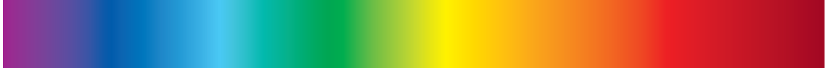

3. Customer relationships: definition and measurement
Customer relationships: the totality of various relationships between the business and customer groups that influence the consumer experience.
Key drivers for building customer relationships:
  Acquiring new customers
  Retaining customers
  Increasing sales
Personal
Automated
Acquisition vs. Retention: tasks and costs?

Slide 25
3. Customer relationships
Types of customer relationships
In-person | Priority customer support | Self-service | Automated services | Communities | Shared value
Building personal relationships Communicating with a real-life employee At the point of sale, by telephone, electronically, etc. E.g.: farm shops, collection points | A customer relations officer deals with a single key account Deepest, most trust-building Long-term E.g. private banking, corporate partnerships, supply | The company does not establish a direct relationship with the customer, but merely creates the conditions for the customer to serve themselves | A more sophisticated form of self-service Automated methods E.g. Personal online profiles – direct access to personalised services E.g. bookshop | Relationships with customers are established through communities Communities created and maintained by companies Knowledge sharing, joint problem-solving Understanding customers | Moving beyond the producer/service provider/consumer relationship; involving customers in value creation E.g. Lego; YouTube

Slide 26
3. Customer Relations
Contact
Sales
Mobilisation
Binding
Functions of customer relations, at process level
Emotional connection
Rewarding loyalty
Intimate relationship
Contract
Subscription
Binding to the system
Technology integration
Quality and customer experience!
Birthday voucher
Premium customers’ night, exclusive event
Cross-selling: e.g. selling follow-up projects: implementation after planning, impact assessment after service delivery
Recommendation of a related product or upgrade
Up-selling (small price difference, greater benefit)
Recommendation
Content sharing
Branded accessories
Customer advisors, advisory boards
Storytelling
Discount for referring a new customer
NO=NO
Purpose
Channels
Available information
Obtaining contact details
Data management/data storage/data security
What processes are built on them?

Slide 27
4. Channels: definition and functions
How does the company communicate with its customers? How does it reach them and how does it present its value proposition to them?
Communication – distribution – sales channels = direct connection between the company and its customers
Channels play an important role in shaping the customer experience.
The functions of channels:
  To attract customers’ attention to the company’s products and services
  To help customers assess/evaluate the value proposition
  Enabling customers to access the products/services
  Deliver value propositions to customers
  Maintain customer relations (customer service) even after the purchase

Slide 28
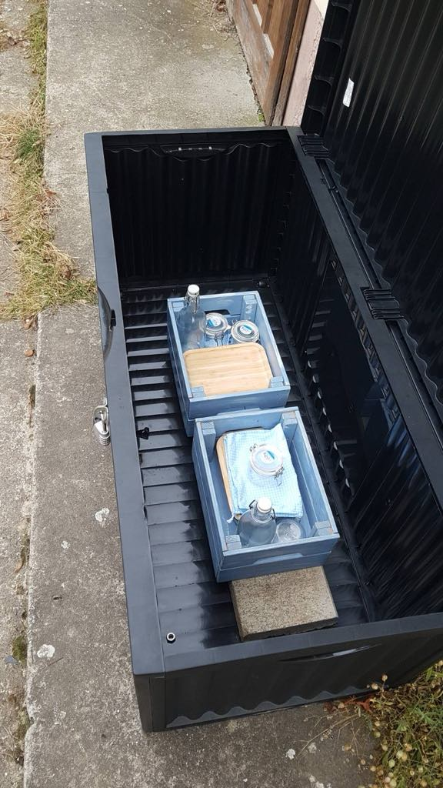



4. Channels
Types and stages, at process level
Types of channels |  |  | Stages of channels
Custom channels | Direct | Agents | 1. Attracting attention How do we spark customers’ interest in our products and services? | 2. Evaluation How do we help consumers evaluate our products? | 3. Purchase How do we enable consumers to purchase specific products/services? | 4. Distribution How do we deliver our value proposition to consumers? | 5. After purchase How do we provide customer support after the purchase?
 |  | Online sales
 | Indirect | Own shops
Partner channels |  | Partner shop
 |  | Wholesale
What are the pros and cons of each type?
How can they be combined?

Slide 29
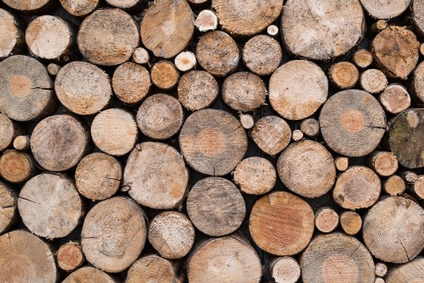
5. Core activities
Key activities: the sum of the business’s most important activities, which are necessary for the business model to function!
Their functions:
Value creation
Reaching markets
Building customer relationships
Generating revenue

Slide 30
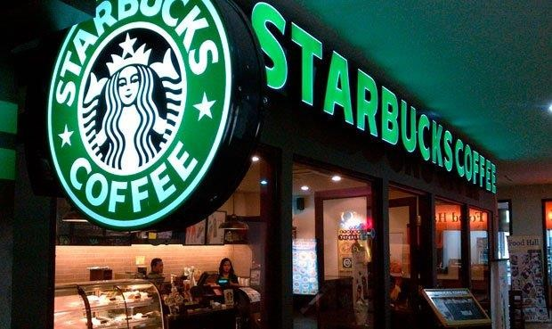
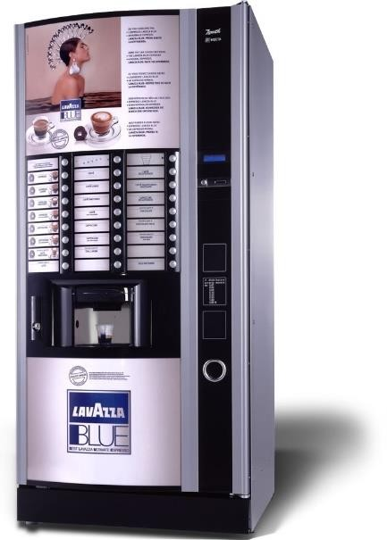
5. Key activities
Different value propositions and target customer groups require different key activities, even within the same industry.
Site selection and fit-out
Marketing
Service (greeting X seconds, serving Y seconds, writing name...)
Deployment
Regular restocking and checks
24-hour service
Thinking through / simulating the customer experience further helps to identify the key factors!

Slide 31
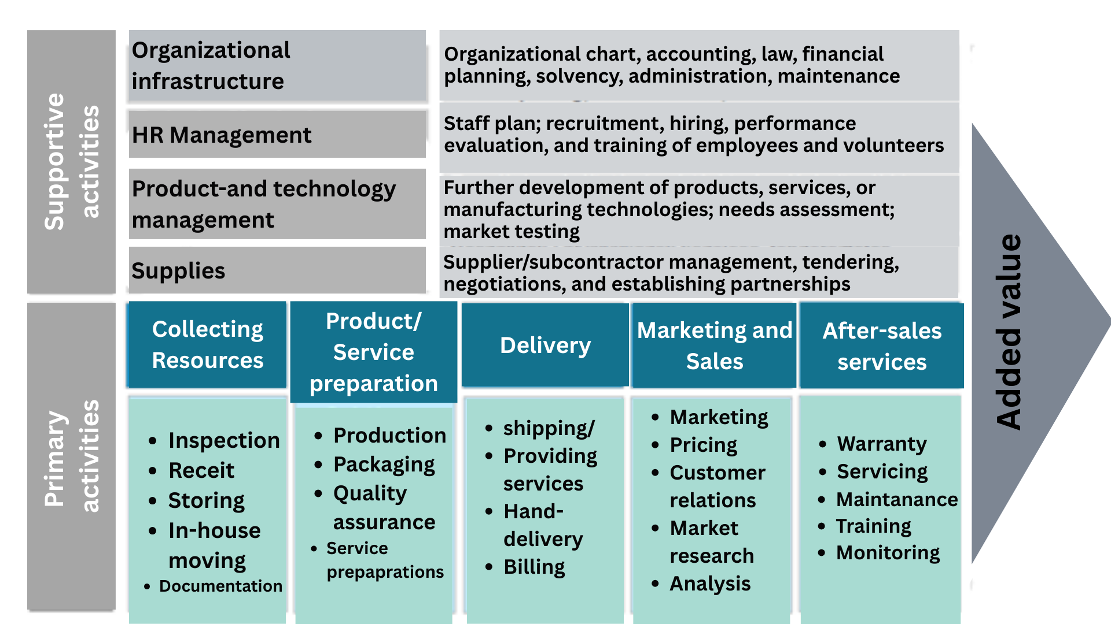
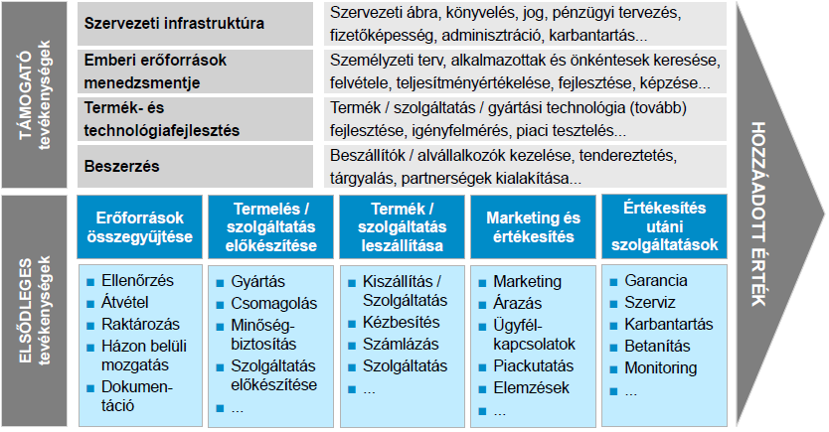
5. Key activities: planning

Slide 32
6. Key resources
Key resources: the most important ‘tools’ required to operate the business model
These are the prerequisites for developing the value proposition, entering the market, maintaining customer relationships, and generating revenue.
Owned by the business (proprietary)
1.
Purchased from partners
2.
Renting/leasing from partners
3.
Joint ownership (community initiative, collaboration)
4.
Tangible/material
Financial
Intellectual
Human

Slide 33
6. Key resources
A few things to bear in mind when planning activities and resources…
To define activities and resources, we need to understand the industry!
For larger costs, consider which is more cost-effective: buying or manufacturing? Outsourcing to a subcontractor or developing the expertise in-house? Buying or renting our machinery?
Possible considerations:
  Duration and scale of demand (One-off or ongoing? Small or large?)
  Replicability / uniqueness (Widely available or do we have to compete for it?)
  Quality (How high are the expectations? How important is it to meet them?)
  Costs and financial options (Which is better for me in the long and short term?)
  Risks (Does this help me avoid significant risks? Is it likely? Is it serious?)
  Importance (Is it really necessary? Does it need to be this good, e.g. fabric for clothing?)

Slide 34
Strategic alliance (between non-competitors)
Strategic partnership (between competitors)
Joint ventures (development of new business lines)
Customer-supplier relationship
7. Key partners
Suppliers and collaborators who contribute to the success of the business model from outside!
Optimising the business model and improving its efficiency
Procurement of resources
Risk mitigation

Slide 35
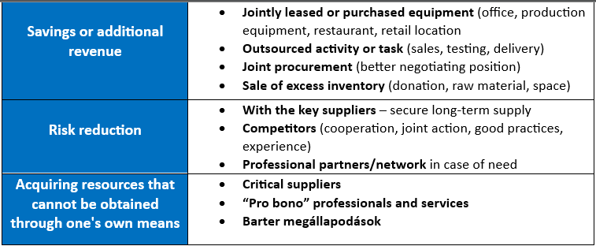
7. Key partners

Slide 36
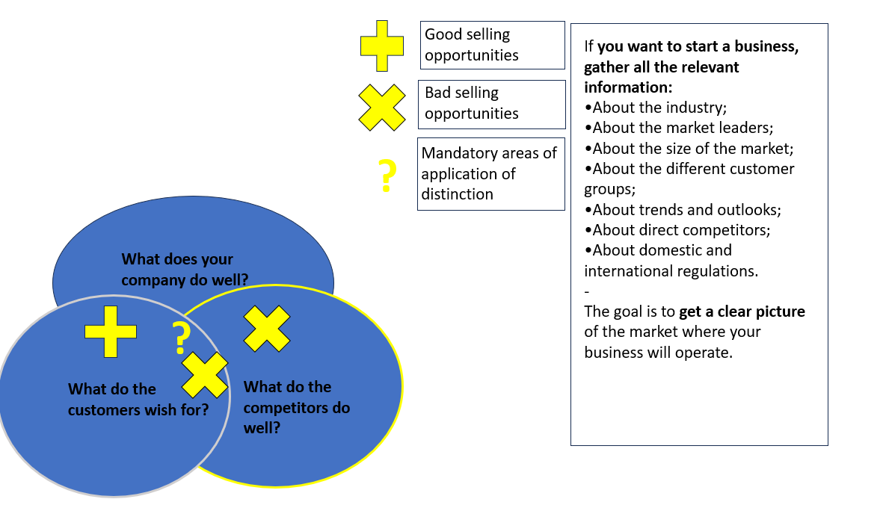
7. Key partners: competitors
Any business or organisation offering a product that attracts the interest of potential customers can be our competitor.
Competition always exists, even if there is currently no other company selling exactly the same product as us! There are still similar or easily substitutable products on the market.
When identifying competitors, consider those who:
Offer the same product/service (direct competitors);
Offer a similar product/service (indirect competitor);
Offer a different product or service that appeals to our potential customers (substitute product).

Slide 37
Who are my competitors, and where are they?
Do they offer the same or a substitute product?
To what extent do our target groups overlap?
How long have they been in business?
Have they had any turning points?
How big are they? What is their financial situation?
What benefits do they offer customers?
What are their prices and pricing policies?
What is their customer service like?
What is their marketing like? Do they have a brand identity? How active are they in their communications?
In what ways could we be better than them / in what ways are we better than them?
What can we learn from them?
Their possible reactions to our market entry....
7. Key partners: Competitor analysis
SWOT analysis
Website analysis
Review of e-reports
Company analysis (e.g. OPTEN, e-company register)
Test purchase

Slide 38
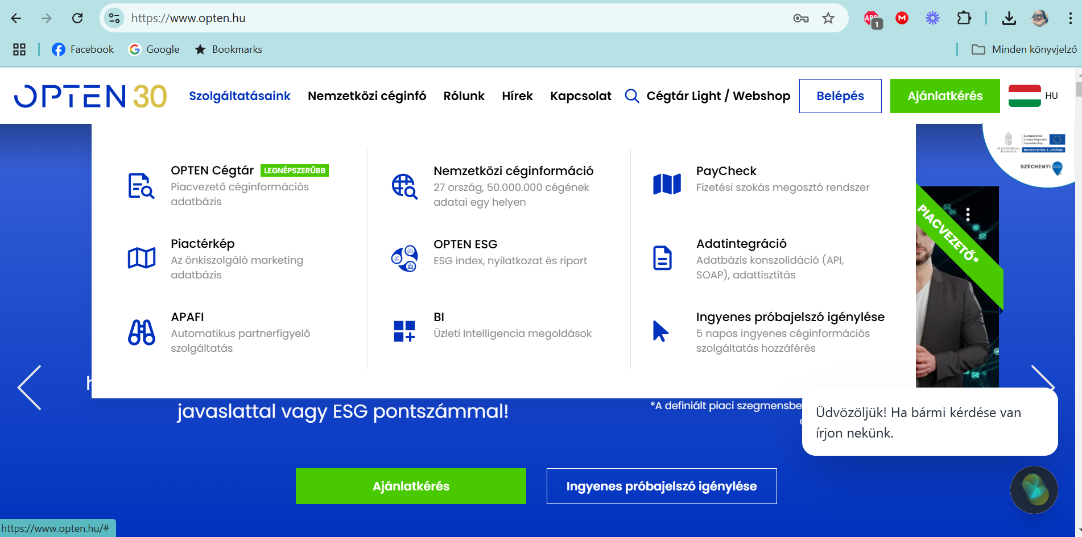
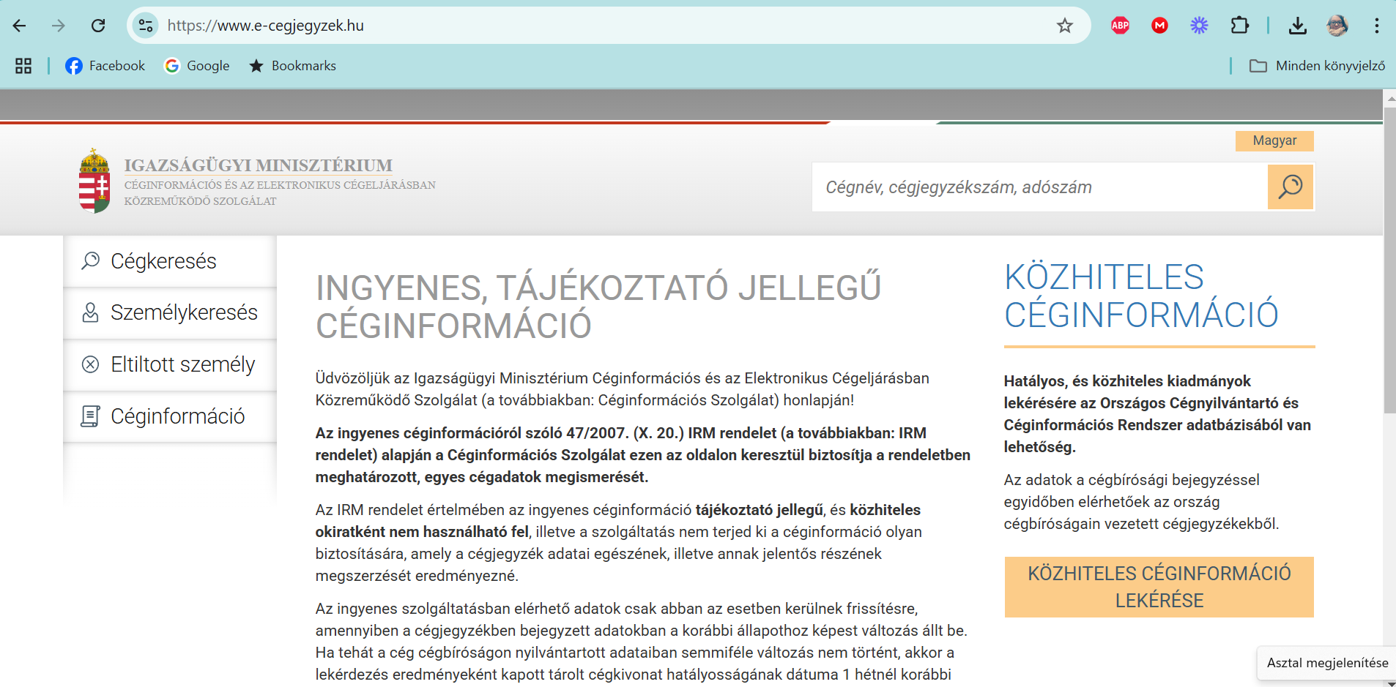
7. Competitor Analysis –
Company Analysis
Free and paid services, various packages
(comprehensive business and operational data, analyses)
Free listing and download of the e-company register (company extract)

Slide 39
8. Cost structure
The cost structure describes all the cost elements required to operate the model!
Planning the cost structure
  Key activities
  Key resources
  Key partners
Different business models are cost-sensitive to varying degrees.
Cost-oriented model Value-oriented model
Business models from a cost structure perspective
Cost-oriented model | Value-oriented model
The aim is to reduce costs. Maximum cost-effectiveness! Low-cost products Automated processes Significant outsourcing E.g. Low-cost airlines | The aim is to create value Premium value propositions Personalised, exclusive services E.g. luxury hotels

Slide 40
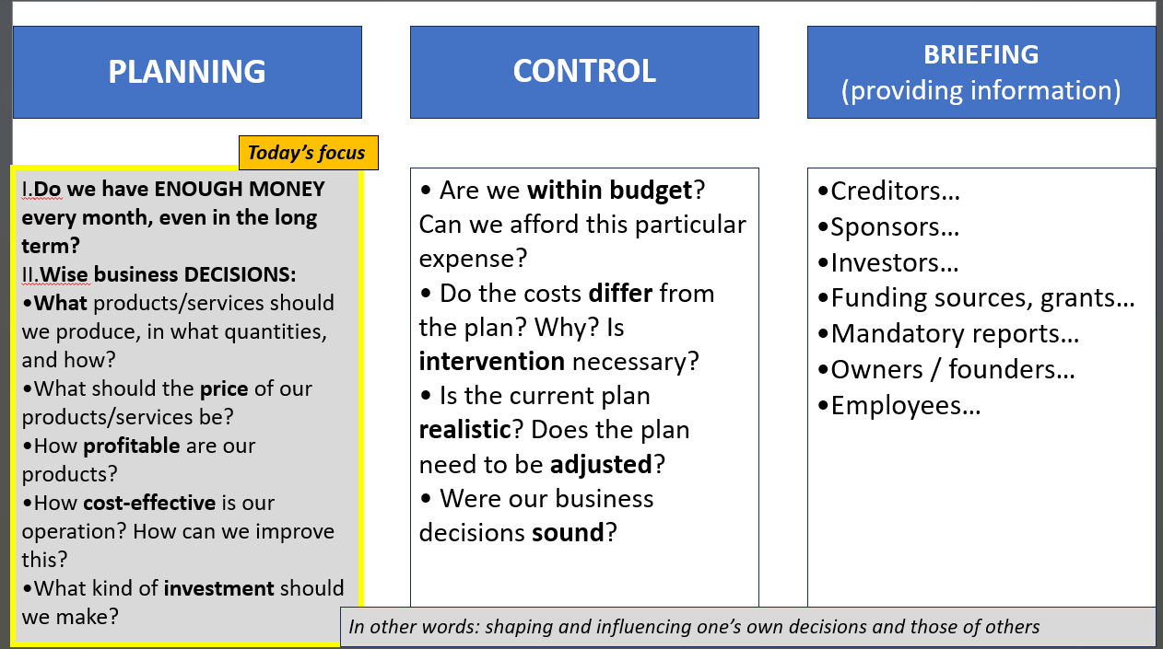
Fixed costs
Variable costs
Plant size
Range of products
8. Cost structure: the components of the cost structure
Why do we concern ourselves with costs at all?

Slide 41
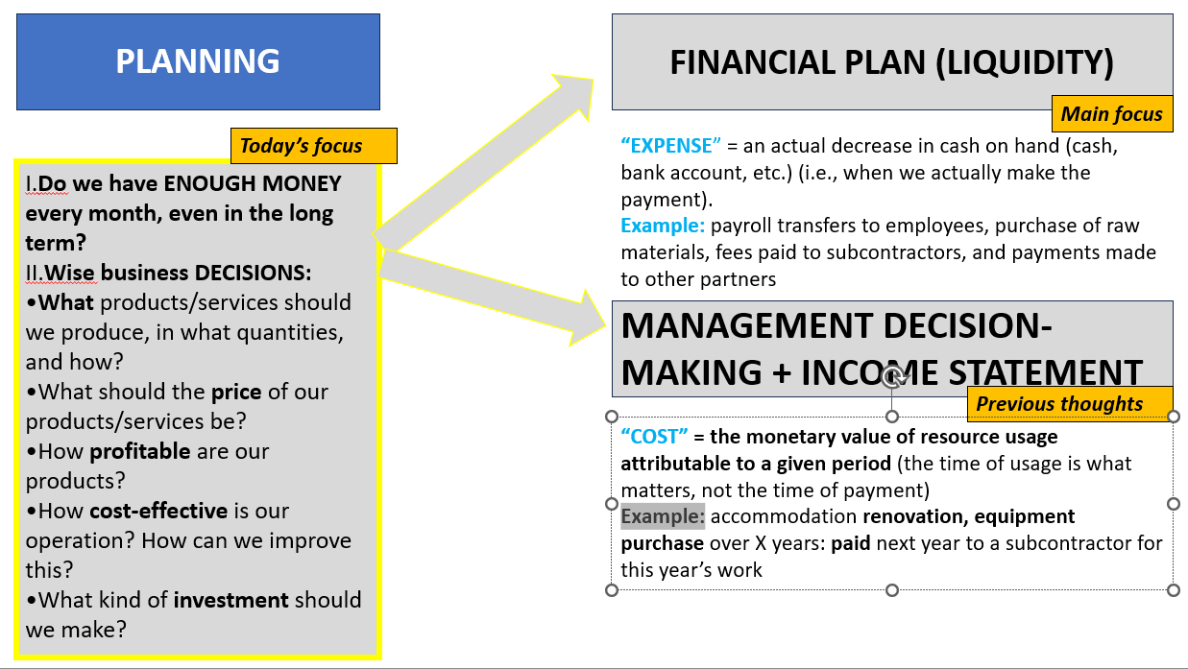
8. Cost structure

Slide 42
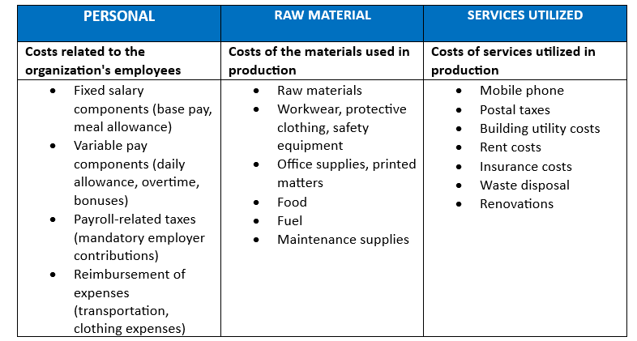
8. Cost structure
Commonly used, widely applied, standardized cost categories

Slide 43
8. Cost structure
EXAMPLE
 | RESTAURANT / CAFÉ | ACCOMODATION
Basic Activity | Customer service process Room renting process | Customer service process
Directly related tasks | Marketing, sales: webpage, FB,… Supplies: raw materials, ingredients Leadership, management/ operational management duties: designing the daily menu, scheduling the waitstaff | Marketing, sales: webpage, FB,… Supplies: shampoo, welcome gifts Leadership, management/ operational management duties: scheduling the cleaning staff
Indirect, supporting tasks | Providing and maintaining infrastructure Personnel Requirements (HR) Administration: bookkeeping, payroll Leadership, management / strategic leadership | Providing and maintaining infrastructure Personnel Requirements (HR) Administration: bookkeeping, payroll Leadership, management / strategic leadership
The general categories can be supplemented with the organisation’s own categories that are relevant, understandable and logical.

Slide 44
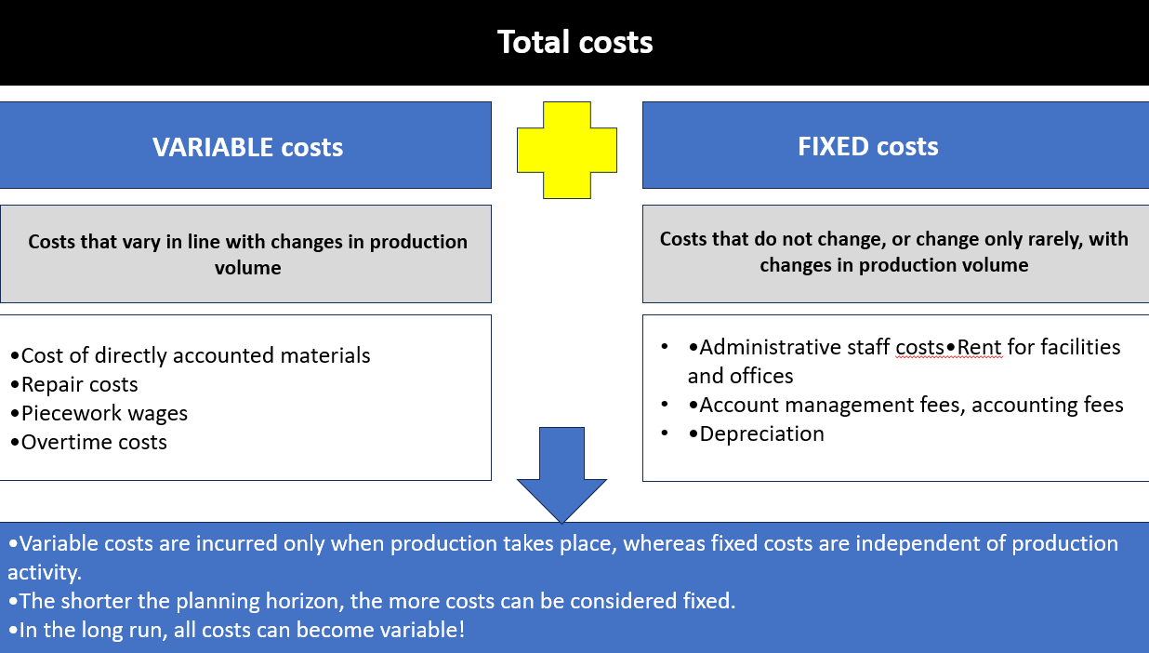
8. Cost structure
Costs that depend on and are independent of production volume (variable and fixed costs).
Where does the value of the work carried out by the entrepreneur appear?

Slide 45
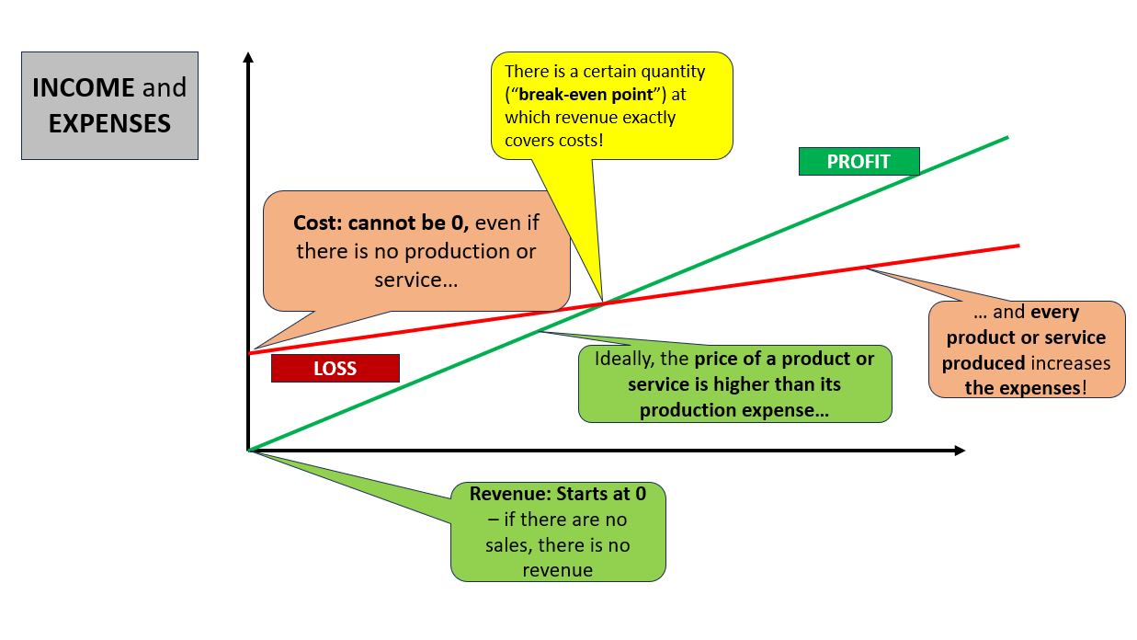
8. Cost structure
The break-even point

Slide 46
Product sales
Usage fee
Rental fee
Loan
Leasing
Licence
Brokerage fee/commission
Advertisement
9. Revenue: types and pricing strategies
Pricing strategies
Fixed pricing Variable but pre-determined pricing | Dynamic pricing Price depends on market factors, changes continuously
List price: fixed price for products and services (value propositions) | Negotiated price: agreed upon by two or more parties
Product-dependent price: The price depends on the quantity/quality of the value proposition’s features | Yield management: a price determined by inventory and booking time, commonly seen for products with a short validity period (airline tickets, hotel rooms, concert tickets)
Customer group-dependent pricing: The price depends on the type and characteristics of the customer group | Real-time market: prices dynamically determined by supply and demand
Quantity-dependent price: The price depends on the quantity purchased | Auction: the price is determined by the winning bid generated by bidders.
Recurring or transactional revenue?

Slide 47
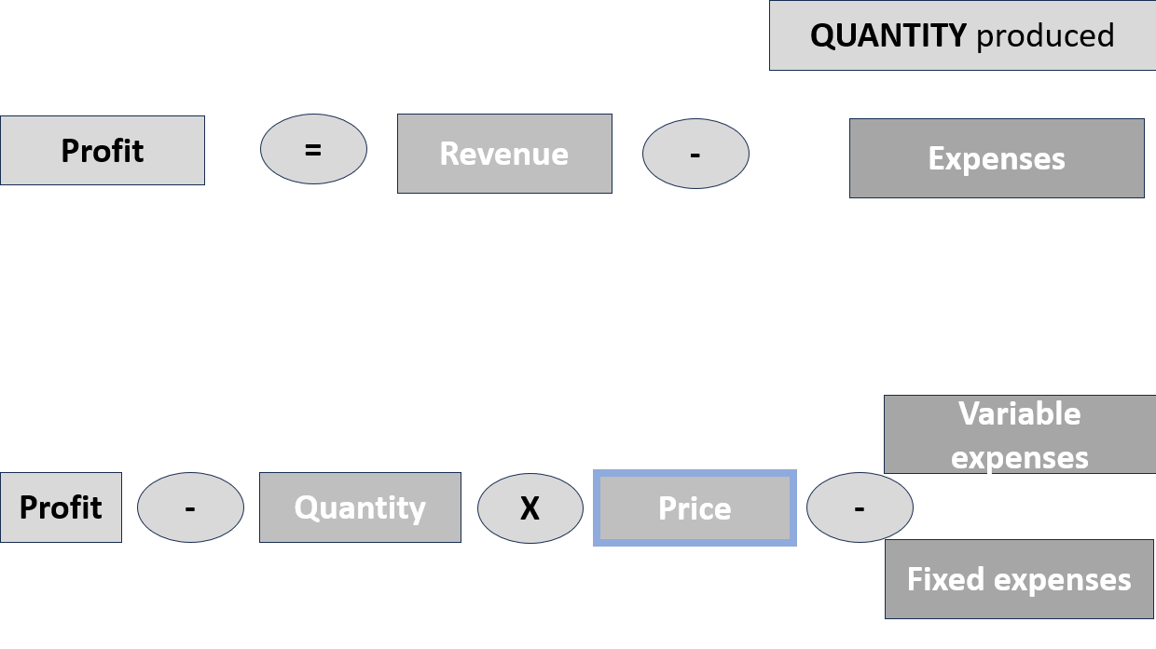
9. Revenue
A realistic, well-founded, accurate and well-documented revenue plan is attractive and vital...
  It is necessary because without it...
    ... we get a false picture of the business’s sustainability,
    ... we cannot convince investors or lenders,
    ... we cannot optimally plan our business model, our work or our financing,
    ... we cannot benchmark, measure or take action,
    ... we cannot motivate the team based on performance.
  Yet, so many revenue plans are unrealistic, unfounded, inaccurate or not convincingly documented!

Slide 48
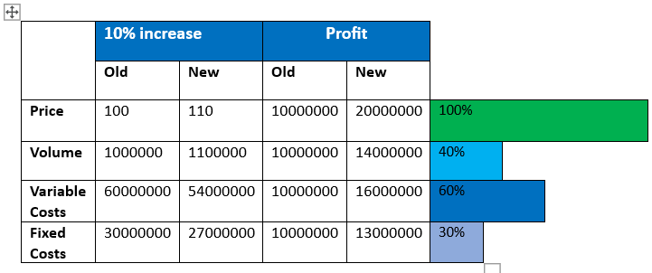
9. Revenue: the importance of pricing

Slide 49
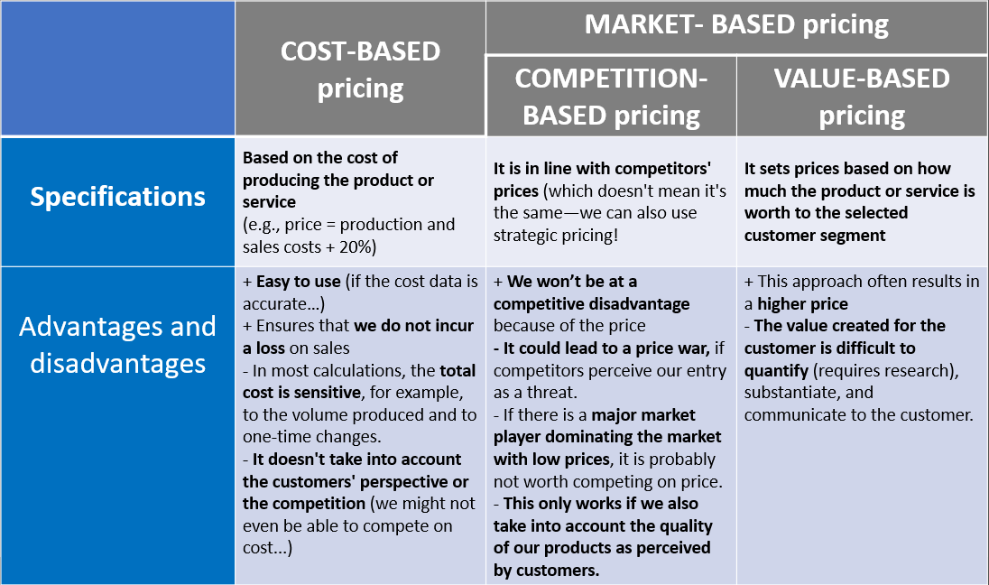
9. Revenue: pricing strategies

Slide 50
Market insight – trends, growing needs
The importance of videos
Creative communities
Sustainability
Inclusion and diversity
Slowing population growth
The transformation of social media
AI
Innovation
Retail media
Live streaming
How can these challenges be addressed in the familiar BMC areas, and how can these opportunities be capitalised on? What response can we offer to them?

Slide 51

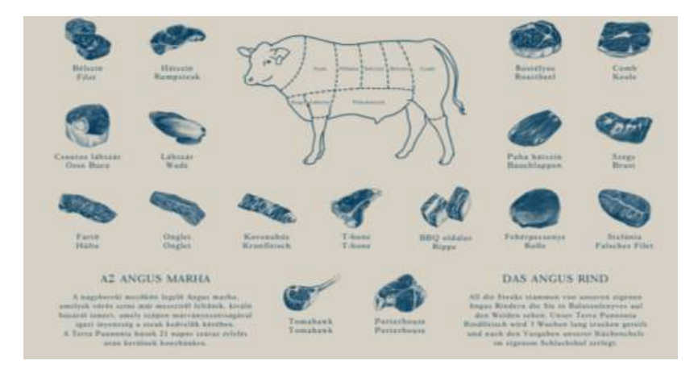
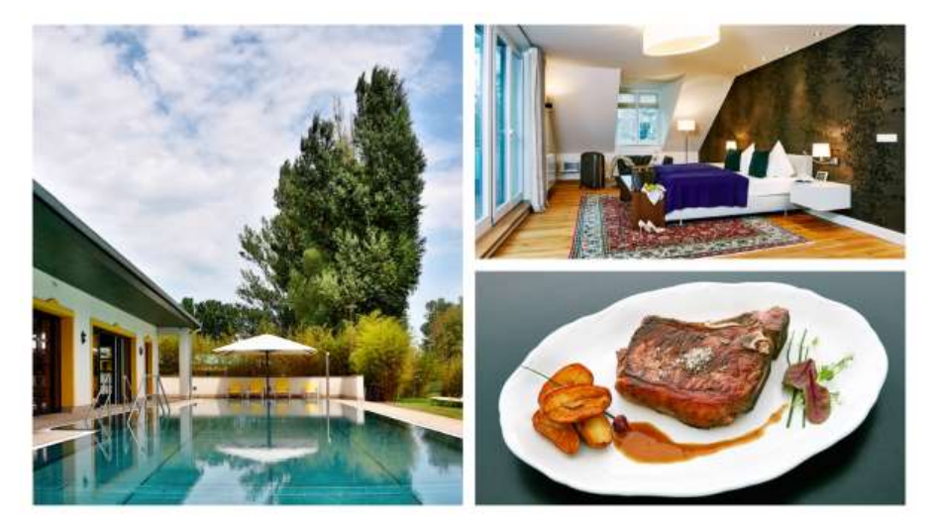
Case study:
Source: Dr Tibor Csizmadia, Adrienn Dékány Let’s get started! Through agricultural fodder production and high-quality beef cattle farming, an excellent Angus steak ends up on the table!

Slide 52
Business Model Canvas (BMC): a model to help with essential decisions
Who are you?
Who are your potential customers? What characteristics define them?
What value proposition do you offer in the market?
What are your most important substitute products?
What types of customer relationships do you maintain, and through which channels?
What are your key activities and resources that you rely on during operations?
Who are your key partners? Who are your main competitors?
What are your most important (fixed and variable) cost items and revenue streams? How do you set your prices?
1–2 sentences per question, 3 minutes in total!
BMC-based introduction

Slide 53
THANK YOU FOR YOUR ATTENTION!
Funded by the European Union. The views and statements expressed herein reflect the views of the author(s) and do not necessarily reflect the official position of the European Union or the Education, Audiovisual and Culture Executive Agency (EACEA). Neither the European Union nor the EACEA can be held responsible for them.

